Slide 1

Digital Music Store Analysis

Slide 2
Objective of Project
Examine the Data using SQL to help the Store understand its business growth and business strategy.
Design and implement a relational database for a music store,
Utilizing SQL to efficiently manage and query data related to artists, album, tracks, customers, sales.
The goal is to create a robust and user-friendly database system that supports various functionalities within a music retail environment.

Slide 3

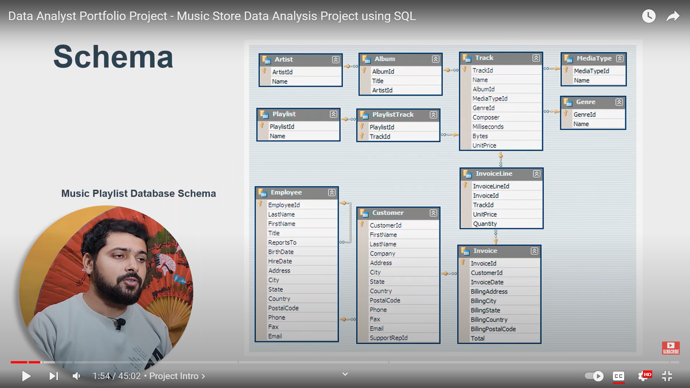
ENTITY RELATIONSHIP DIAGRAM

Slide 4
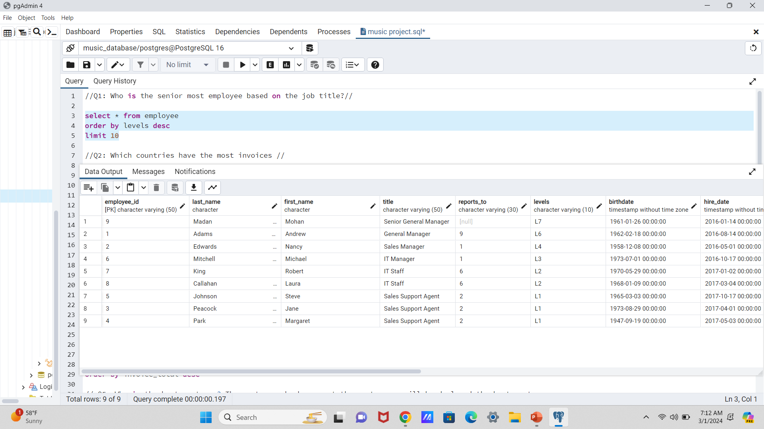
Q1: Who is the senior most employee based on the job title?

Slide 5
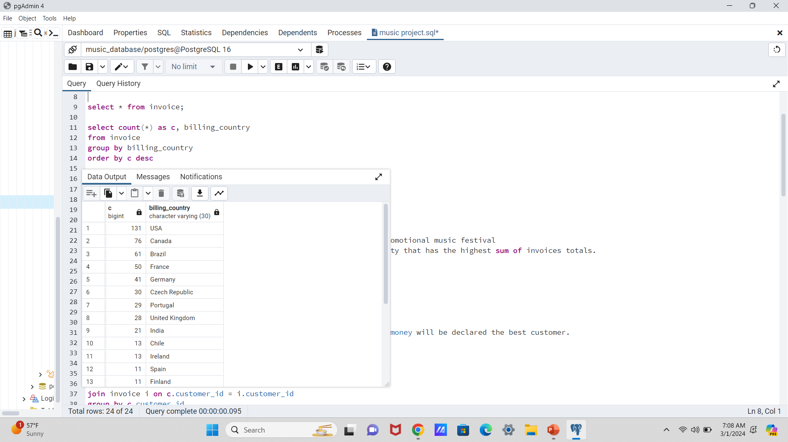
Q2: Which countries have the most invoices

Slide 6
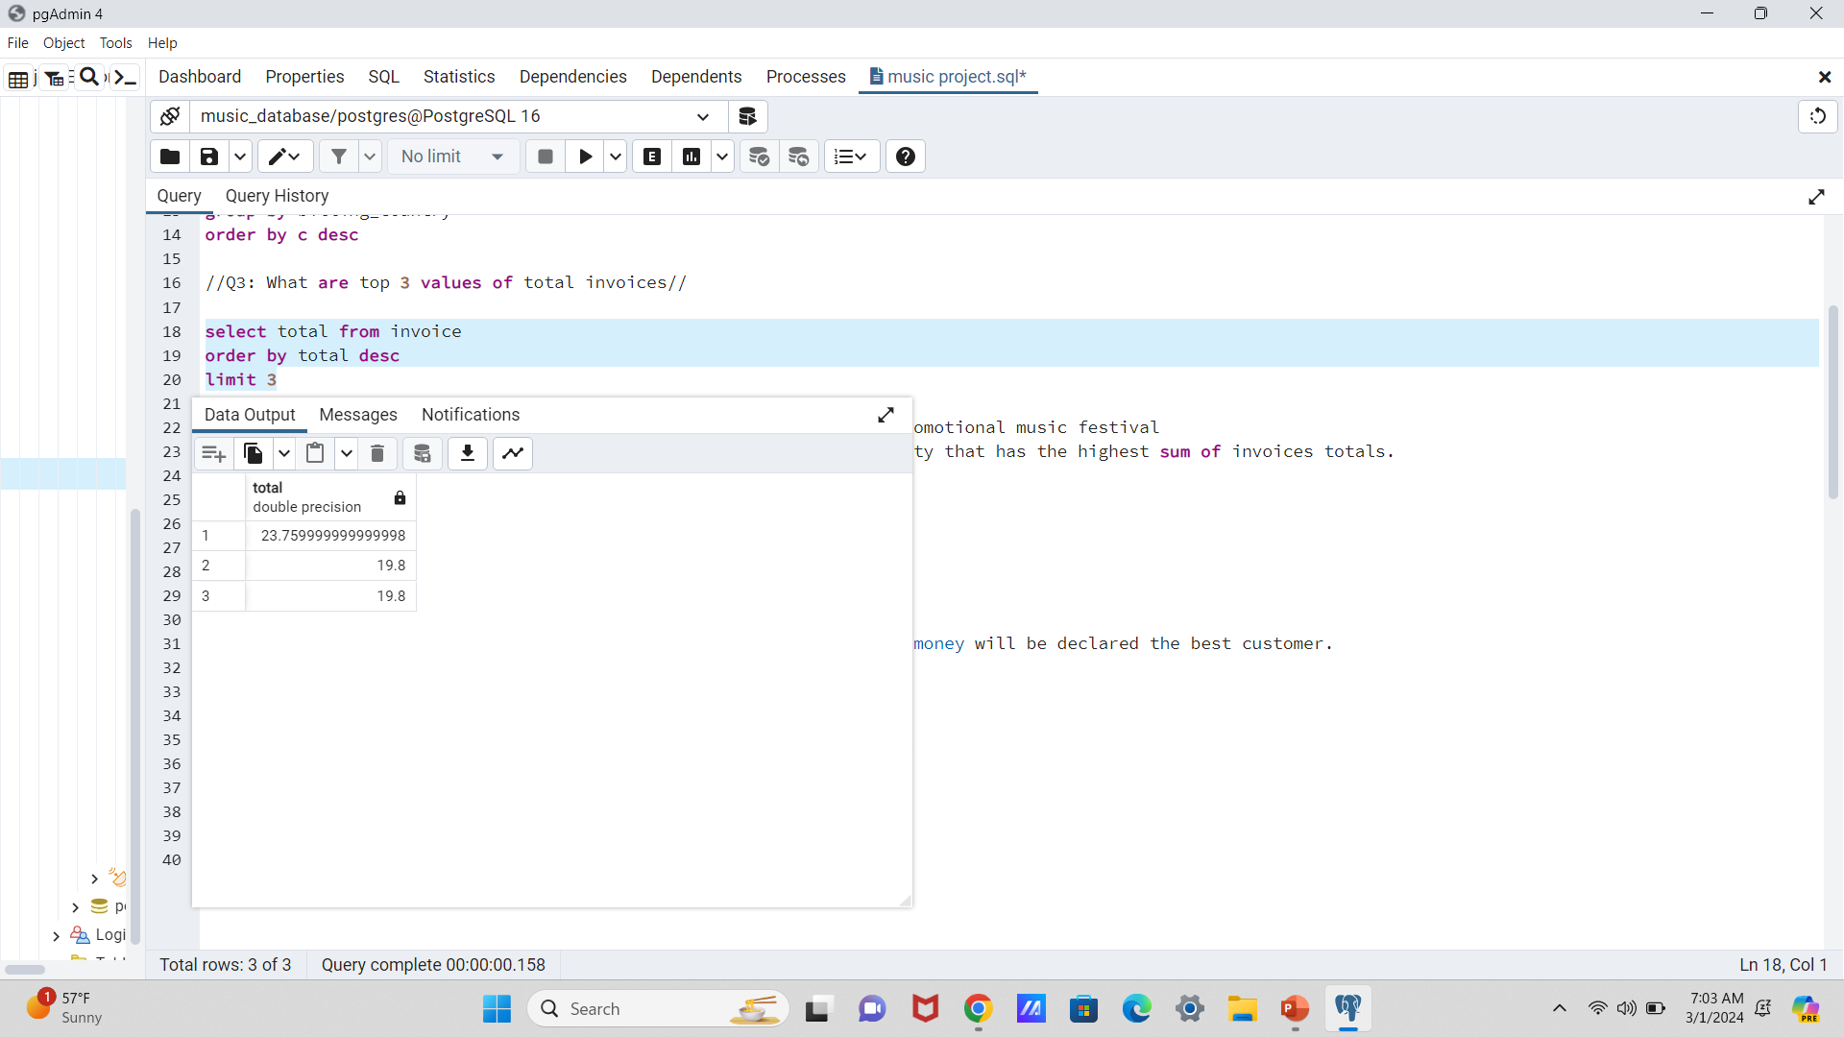
Q3: What are top 3 values of total invoices?

Slide 7
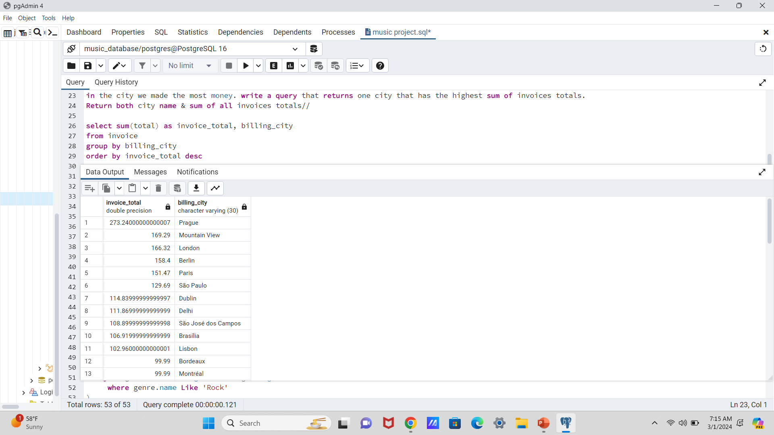
Q:4 Which city has the best customers? we would like to throw a promotional music festival
in the city we made the most money. write a query that returns one city that has the highest sum of invoices totals.
Return both city name & sum of all invoices totals

Slide 8
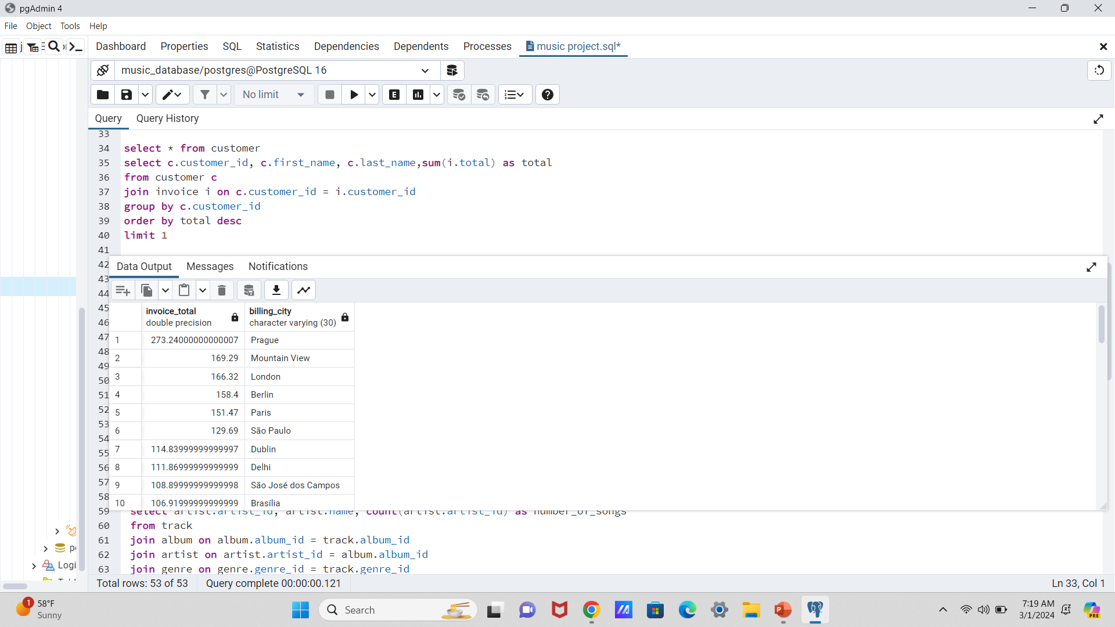
Q5: Who is the best customer? The customer who has spent the most money will be declared the best customer.
Write a query that returns the person who has spent the money.

Slide 9
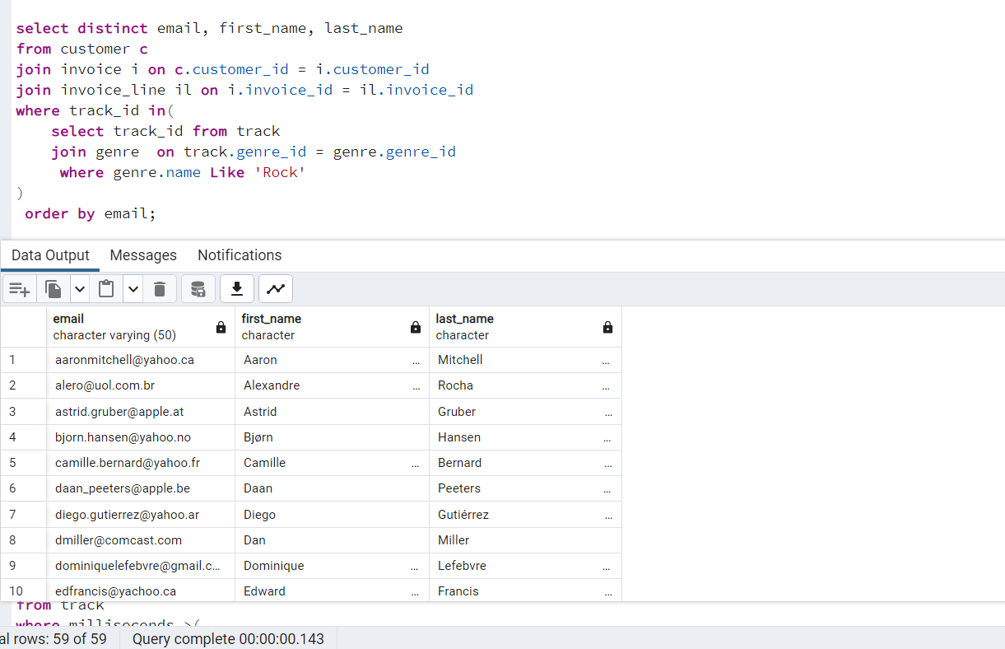
Q6: Write query to return the email, first name, last name, & Genre of all Rock Music Listener.
Return your list ordered alphabetically by email starting with A?

Slide 10
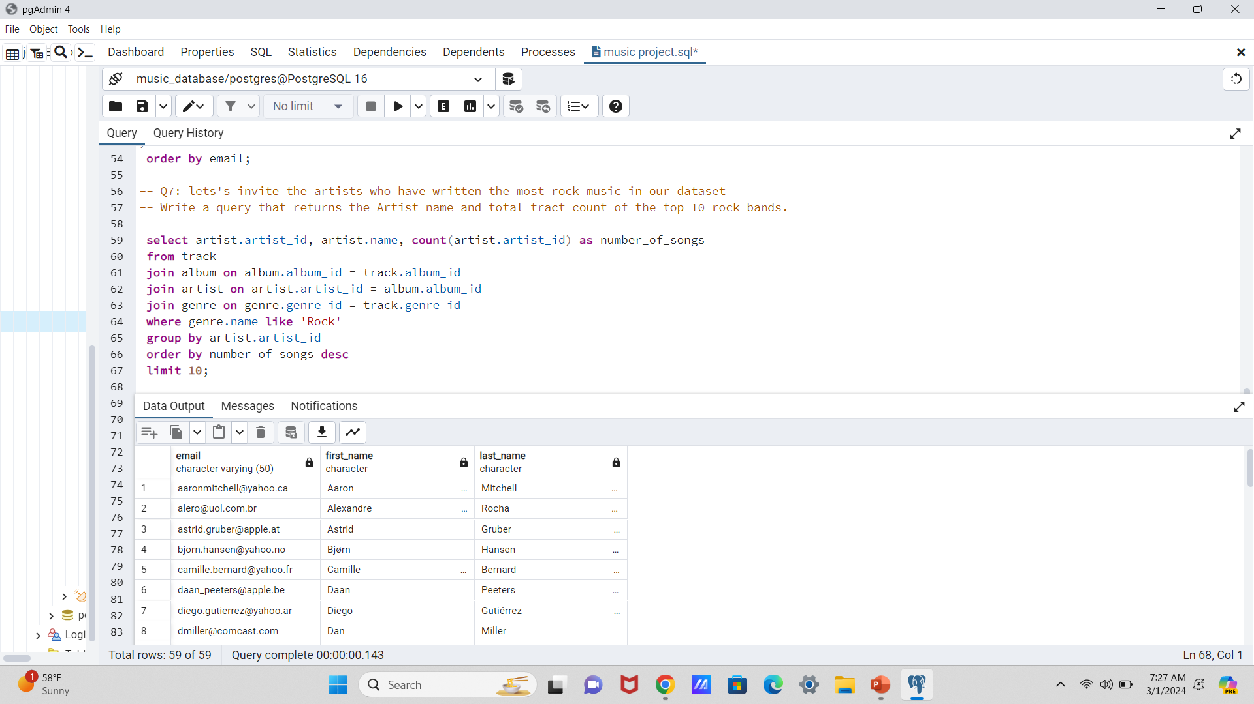
Q7: let's invite the artists who have written the most rock music in our dataset
-- Write a query that returns the Artist name and total tract count of the top 10 rock bands.

Slide 11
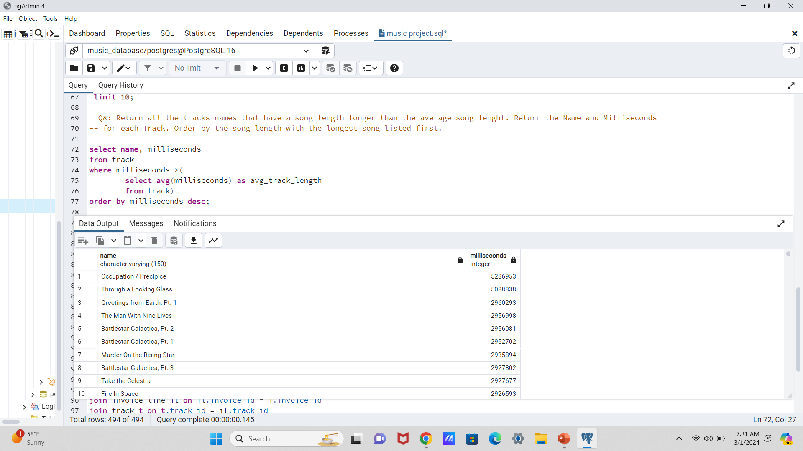
--Q8: Return all the tracks names that have a song length longer than the average song length. Return the Name and Milliseconds
-- for each Track. Order by the song length with the longest song listed first

Slide 12
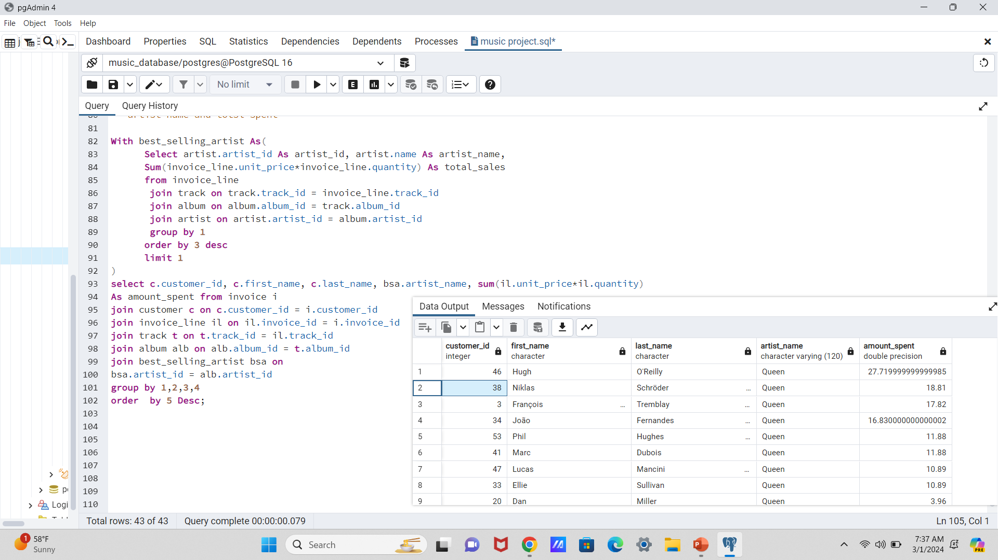
Q9: Find how much amount spent by each customer on artists? Write a query to return customer name,
-- artist name and total spent?

